Slide 1
Semantic Analysis
Type Checking !!!

Slide 2
Topics Covered in Lecture 9
1

Slide 3
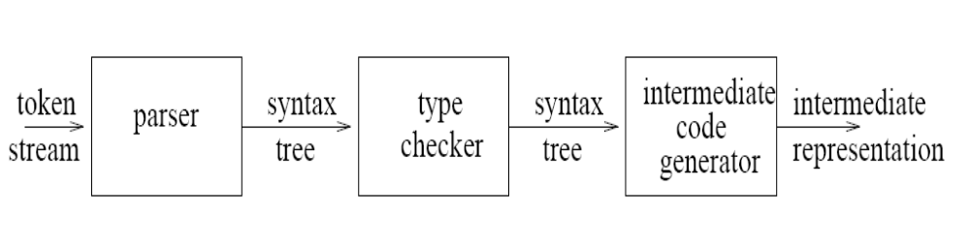
Our journey towards Type checker

Slide 4
Typical Semantic Actions
Enter variable declaration into symbol table
Look up variables in symbol table
Do binding of looked-up variables (scoping rules, etc.)
Do type checking for compatibility
Keep the semantic context of processing
a + b + c ⇒ t1 = a + b
t2 = t1 + c
Semantic
Context

Slide 5
How Are Semantic Actions Called?
Action symbols embedded in the grammar
  Each action symbol represents a semantic procedure
  These procedures do things and/or return values
Semantic procedures are called by parser at appropriate places during parsing
Semantic stack implements & stores semantic records

Slide 6
Semantic Actions
<decl-stmt> → <type>#put-type<var-list>#do-decl
<type> → int | float
<var-list> → <var>#add-decl <var-list>
<var-list> → <var>#add-decl
<var> → ID#proc-decl
#put-type puts given type on semantic stack
#proc-decl builds decl record for var on stack
#add-decl builds decl-chain
#do-decl traverses chain on semantic stack using
backwards pointers entering each var into symbol table
decl record
id3
Name
Type
Scope
id2
#do-decl
⇒
id1
1
3
id1
id2
1
3
type
id3
1
3

Slide 7
Semantic Actions
What else can semantic actions do in addition to storing and looking up names in a symbol table?
Two type of semantic actions
  Checking (binding, type compatibility, scoping, etc.)
  Translation (generate temporary values, propagate them to keep semantic context).

Slide 8
Type Checking
Types help identify errors if an operator is applied to an incompatible operand
For example :
  Int x;
  String y;
  Int z = x / y;
  Should generate a type error !!!

Slide 9
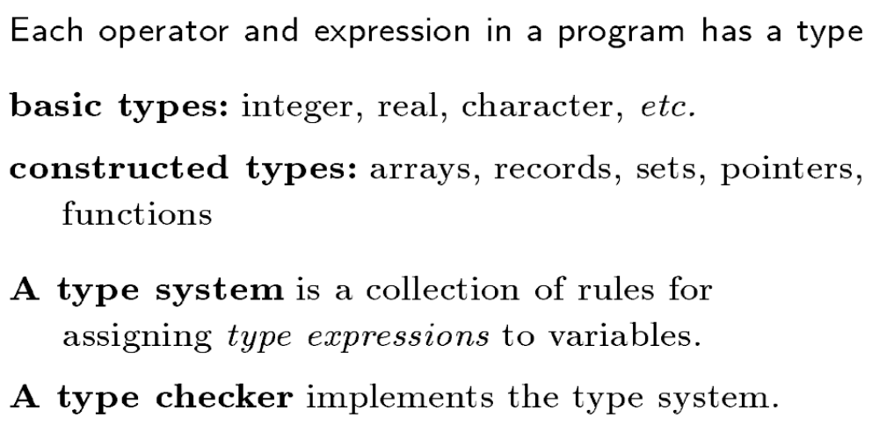
Concepts about type checking

Slide 10
Type Checking
• Type checker
  – Enforces rules of type system
  – May be strong/weak, static/dynamic
• Static type checking
  – Performed at compile time
  – Early detection, no run-time overhead
  – Not always possible (e.g., A[i])
• Dynamic type checking
  – Performed at run time
  – More flexible, rapid prototyping
  – Overhead to check run-time type tags

Slide 11
Type Checking
• Type equivalence
  – When are the types of two values the same?
• Type compatibility
  – When can a value of type A be used in a context that expects type B?
• Type inference
  – What is the type of an expression, given the
  types of the operands?

Slide 12
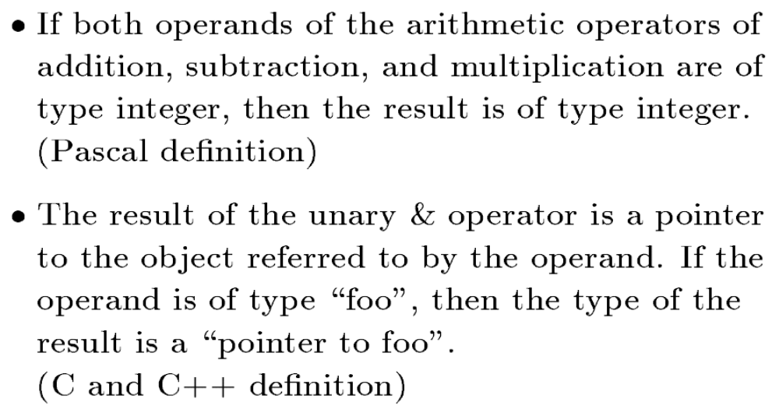
Type Rules : Learn by Example

Slide 13
Type Expressions
• Type expressions
  – Used to represent the type of a language construct
  – Describes both language and programmer types
• Examples
  – Basic types: integer, real, character, …
  – Constructed types: arrays, records, pointers,
  functions, …
• Constructing new types
  – Arrays
  – Records
  – Pointers
  – Functions

Slide 14
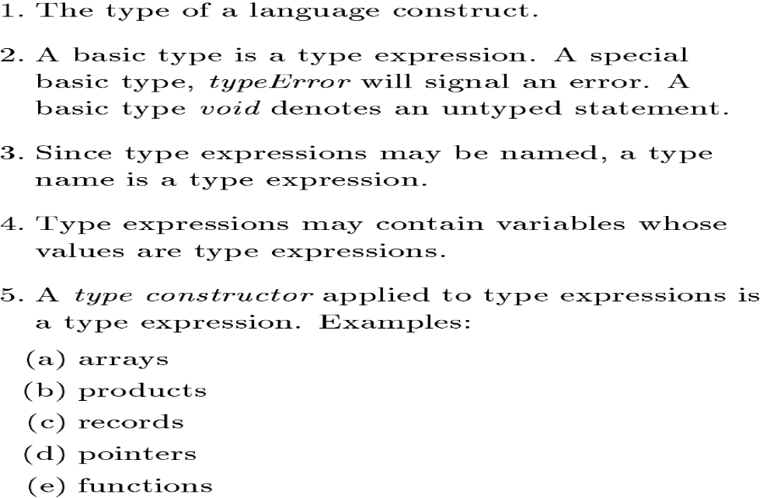
Type Expressions

Slide 15
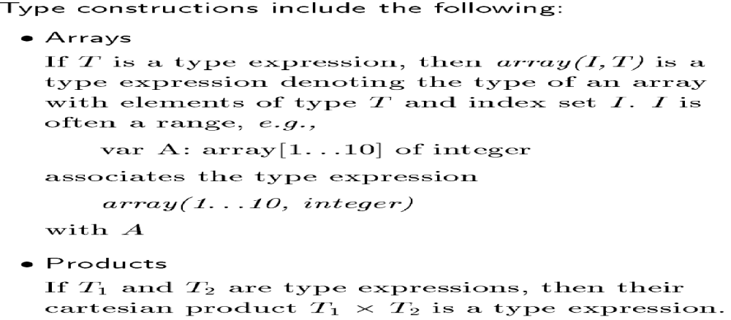
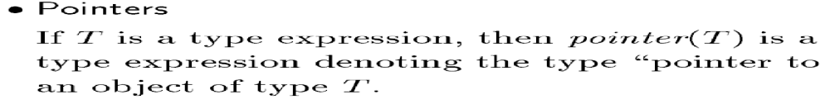
Type Constructors

Slide 16
Semantic Analysis
A simple type checker

Slide 17
Making Type Checkers - Learn by Example
Lets make a type checker for a language in which the type of each identifier must be declared before the identifier is used.
Which means
  int a , b;
  a = b + 2 ;
  Valid for our language
While
  int b;
  a = b + 2
  Invalid because we can not know whether a can hold an integer sum

Slide 18
A simple type checker
Grammar for source language
  P → D ; E
  D → D ; D | id : T
  T → char | integer | array [num] of T | ↑ T
  E → literal | num | id | E mod E | E[E] | E ↑
Therefore, we need to understand four grammar elements
  Program
  Declaration
  Type
  Expression

Slide 19
Understand Declarations in Grammar by example
D → D ; D | id : T
  key : integer
  key : integer ; lock : char
Assigns type integer to identifier key
OR we can save in symbol table as
addType ( id. entry , T. type )
A declaration can be followed by a declaration

Slide 20
Understand Types in Grammar by example
  T → char
  | integer
  | array [num] of T
  | ↑ T
  section : char
  key : integer
  marks : array[5] of integer
  reference : pointer to integer

Slide 21
Understand Types in Grammar
T → char
| integer
| array [num] of T
| ↑ T
We can say that the grammar has
  Two basic types
    Char
    Integer
  Two constructed types
    Array
    pointer

Slide 22
Understand Basic Types in Grammar
T → char
  Means that the type to be assigned is character
  OR in symbol table we store
  T . type = char
T → integer
  Means that the type to be assigned is integer
  OR in symbol table we store
  T . type = integer
What if an identifier is assigned type real ?
Your type checker should generate an error !!!
Therefore, we add another basic type
T → type _ error
  Means that the type to be assigned is integer
  OR in symbol table we store
  T . type = type_error

Slide 23
Understand Constructed Types in Grammar
T → array [ num ] of T₁
  Means that construct array of type T₁ having elements ranging from 1 to num
  Assume that all arrays start from index 1
  OR in symbol table we store
  T . type = array ( from 1 to num . value , T₁ .type)
    marks : array[5] of integer
    Marks will have type
    array ( 1 . . 5 , integer)
T → ↑ T₁
  Means that construct a pointer of type T₁
  OR in symbol table we store
  T . type = pointer ( T₁ . type)
    reference : ↑ integer
    reference will have type
    pointer ( integer)

Slide 24
Learn by Example
Declarations in Program
  Key : integer
  Class : array [25] of char
How to store in symbol Table ?
  Key : integer
    T. type = integer
    addType ( key. entry , T . type)
  Class : array [25] of char
    T. type = array ( 1..25 , char)
    addType ( class. entry , T. type)

Slide 25
Learn by Doing
Declarations in Program
  Key : ↑ char
  marks : array [100] of integer
  Comments : real
How to store in symbol Table ?
  Key : ↑ char
    T. type = pointer ( char )
    addType ( key. entry , T . type)
  marks : array [100] of integer
    T. type = array ( 1..100 , integer)
    addType ( marks . entry , T. type)
  Comments : real
    T . type = type _ error
    addType ( comments . entry , T . type)

Slide 26
A simple type checker
Grammar for source language
  P → D ; E
  D → D ; D | id : T
  T → char | integer | array [num] of T | ↑ T
  E → literal | num | id | E mod E | E[E] | E ↑
Therefore, we need to understand four grammar elements
  Program
  Declaration
  Type
  Expression

Slide 27
Understand Programs through examples
P → D ; E
  key : integer
  key mod 1999
Program P consisting of Declarations D followed by Expressions E

Slide 28
Understand Expressions through examples
A sequence of characters
E → literal
| num
| id
| E mod E
| E[E]
| E ↑
A sequence of integers
Variable name
10 mod 2 generates zero
Marks[2] returns value at index 2 of array named marks
Object pointed to by pointer E

Slide 29
Type Checking of Expression
E → literal
  E . type := char
  Constant represented by the token literal have type char
E→ num
  E . type := integer
  Constant represented by the token num have type integer

Slide 30
Type Checking of Expression
E → id
  E . type := lookup ( id . entry)
  lookup (e) fetches type saved in symbol table entry pointed by e
  Whenever an identifier is mentioned in an expression, its declared type is fetched from symbol table by lookup function

Slide 31
Type Checking of Expression
E → E₁ mod E₂
  Mod operator returns the remainder when a number is divided by another number
  E . type := if (E₁.type=integer && E₂.type=integer) then integer
  else type_error
  Learn by Example
    w : integer ;
    x : integer ;
    y : char ;
    z : integer;
    x mod y ( yields a type error)
    x mod w ( yields an integer value)

Slide 32
Type Checking of Expression
E → E₁ [E₂]
  Reference to individual array elements is possible only if an integer index is used with the array name
  E . type :=if (E₁.type=array(s,t) && E₂.type=integer) then t
  else type_error
  Learn by Example
    w : integer;
    marks : array [100] of integer;
    z : integer;
    x : char;
    marks [w] ( returns the integer at index w of marks)
    marks [x] ( yields a type error)

Slide 33
Type Checking of Expressions
E → E₁ ↑
  Post fix operator ↑ returns object pointed by its operand
  Type of E₁ ↑ is type t of the object pointed to by pointer E₁
  E . type := if ( E₁.type==pointer(t) )
  then t
  else type_error
  Learn by Example
    x : char;
    reference : ↑ integer
    z : integer;
    reference ↑ ( returns integer as reference points to integer)

Slide 34
A simple type checker
Grammar for source language
  P → D ; E
  D → D ; D | id : T
  T → char | integer | array [num] of T | ↑ T
  E → literal | num | id | E mod E | E[E] | E ↑
We now know about each of the following elements
  Program
  Declaration
  Type
  Expression

Slide 35
Learn by Example
Program
  Key : integer;
  Key mod 1999
How the type checker works
  T. type = integer
  addType ( key. entry , T . type)
  E₁.type= lookup (key . entry)
  E₂.type= integer (because1999 generates token num)
  If (E1.type = integer) && (E2.type = integer)
    then integer
    else type error
  E.type=integer

Slide 36
Learn by Doing
Program
  Key : array[100] of char;
  Key[5]
How the type checker works
  T. type = array ( 1..100 , char)
  addType ( key. entry , T . type)
  E₁.type= lookup (key . entry)
  E₂.type= integer (because 5 generates token num)
  If (E1.type = array (1..100 , char) && (E2.type = integer)
    then char
    else type error
  E.type=char

Slide 37
Lets Revise

Slide 38
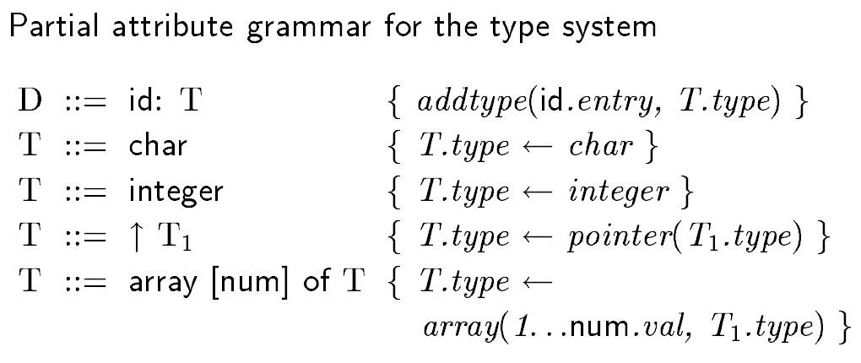
A simple type checker

Slide 39
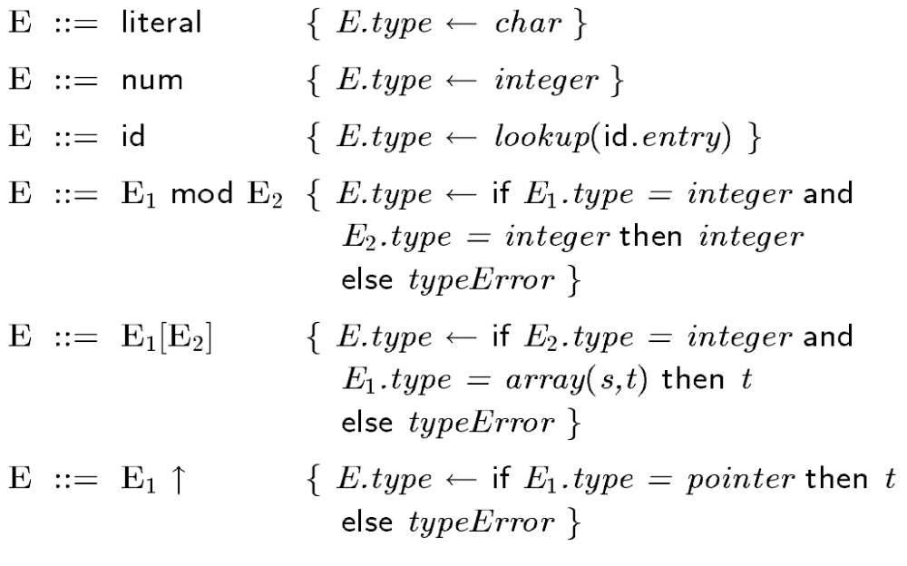
Type checking of expression

Slide 40
Homework !
Sort out how the type checker will work for the following program
  Name : char
  Hobby : array [ 10] of char
  NumberOfHobbies : integer
  Reference : ↑integer
  NumberOfHobbies mod 2098
  Hobby [name]
  Reference ↑

Slide 41
QUIZ ! BSCS-F18 (23-12-2021)
Sort out how the Lexical Analyzer, Parser and Type Checker will work for the following program:
int a, b;
float c;
cin >> a >> b;
c = a + b;
if (a > b)
{
char c = ‘A’;
cout << c;
}

